Slide 1
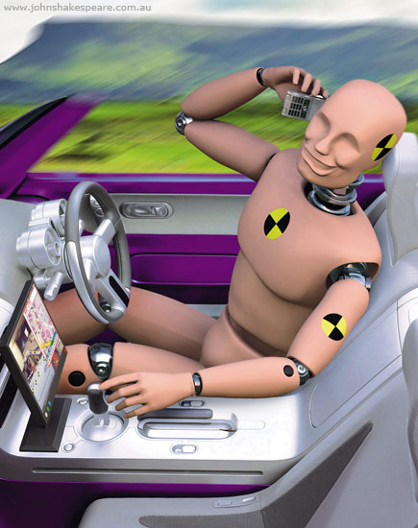
Cognitive Crash Dummies: Predictive Human Performance Modeling for Interactive System Design
Bonnie E. John*
Symbiotic Cognitive Systems,
IBM T. J. Watson Research Center
* All examples and exercises in this course were created while instructor was faculty at Carnegie Mellon University
Notes:
Illustration used by permission of illustrator, John Shakespeare, 10aug08.

Slide 2
Who’s here?
Me:
Brief background
You:
Name, organization
Professional or educational background, e.g., human factors, UI design, CS, other?
What experience do you have with predictive human performance modeling
What do you hope to get out of this workshop?
Has everyone downloaded the materials?
Get the CogTool executable, for Mac or PC, and the User Guide at https://github.com/cogtool/cogtool/releases/tag/1.2.2
Get the Course Exercise Materials at https://github.com/cogtool/cogtool/releases

Slide 3
Agenda of this workshop
Introduction to predictive human performance modeling
Introduction to CogTool
Hands-on exercises in CogTool
Break
Continuation of hands-on exercises
The future of predictive human performance modeling

Slide 4
Agenda of this workshop
Introduction to predictive human performance modeling
Introduction to CogTool
Hands-on exercises in CogTool
Break
Continuation of hands-on exercises
The future of predictive human performance modeling

Slide 5
What is predictive human performance modeling?
Computer-based computational model that mimics human behavior
Perception
Cognition
Motor actions
Several computational cognitive architectures exist, i.e., ACT-R, Soar, EPIC, which provide
A structure of modules and communication between them
A programming language for expressing human knowledge and capabilities
When a model runs, it produces a trace from which human performance metrics can be extracted and compared to human data,e.g.,
Time it takes to do a task
Number of errors
Blood oxygen level
Psychologist use human performance models to develop and test theories of human capabilities
Software engineers can use human performance models to help design and test interactive computer systems
5

Slide 6
Uses of human performance models in interactive system design
Predict human behavior on a proposed design before implementing that design
Construct systems that adapt to the user, e.g., cognitive tutoring systems
Substitute for human participants in collaborative or combative training situations
6
Notes:
Illustration used by permission of illustrator, John Shakespeare, 10aug08.

Slide 7
Uses of human performance models in interactive system design, aka Cognitive Crash Dummies
Predict human behavior on a proposed design before implementing that design
Construct systems that adapt to the user, e.g., cognitive tutoring systems
Substitute for human participants in collaborative or combative training situations
7
Notes:
Illustration used by permission of illustrator, John Shakespeare, 10aug08.

Slide 8
Brief History of Cognitive Crash Dummies in interactive system design
In the beginning, there was The Psychology of Human-Computer Interaction (Card, Moran & Newell, 1983)
Coined the phrase that became the name of the field
Presented modeling frameworks for predictive models to evaluate and guide design
They called these models (GOMS and KLM) “Engineering models” of human performance
Notes:
Card, S. K., Moran, T. P., & Newell, A. (1983) The Psychology of Human-Computer Interaction. Lawrence Erlbaum Associates: Hillsdale, NJ.

Slide 9
Characteristics of Cognitive Crash Dummies
A priori quantitative predictions of human performance
Learnable and usable by system designers
Cover total tasks

Slide 10
Characteristics of Cognitive Crash Dummies
A priori quantitative predictions of human performance
Learnable and usable by system designers
Cover total tasks
Usefully approximate

Slide 11
Predicting efficiency of interactive systems
HCI has been doing this for 30 years with the Keystroke-Level Model (Card, Moran & Newell, 1980) (a member of the GOMS family of models, John & Kieras, 1996a,b)
Input:
A suite of benchmark tasks that are important to the target users
A specification of the proposed system
Express the procedure for accomplishing a routine task in terms of a small number of operators:
K (keystroke)
P (point with mouse)
H (home hands between devices)
R (system response time)
M (mental operator)
Place M operators using empirically-established heuristics to coincide with where skilled users pause to visually search or think
Assign each operator an empirically-established execution time
Output:
The time it would take a skilled user to perform the benchmark tasks on the proposed system
11
Notes:
Card, S. K., Morn, Y. P., and Newell, A., (1980) The keystroke-level model for user performance with interactive systems, Communications of the ACM, 23 (1980), 396-210
John, B. E. & Kieras, D. E. (1996) The GOMS family of user interface analysis techniques: Comparison and Contrast. ACM Transactions on Computer-Human Interaction., 3 (4), pp. 320-351.
John, B. E. & Kieras, D. E. (1996) Using GOMS for user interface design and evaluation: Which technique? ACM Transactions on Computer-Human Interaction, 3 (4), pp. 287-319.

Slide 12
Predicting efficiency of interactive systems
Simple as this sounds, it has been perceived as too hard to learn and use by UX designers and developers
12

Slide 13
Agenda of this workshop
Introduction to predictive human performance modeling
Introduction to CogTool
Hands-on exercises in CogTool
Break
Continuation of hands-on exercises
The future of predictive human performance modeling

Slide 14
Introduction to CogTool
Goal: Make it easier to construct human behavior models
Reduce the cost of learning and creating valid cognitive models
“Toe in the door” philosophy
First, make the simplest models (KLM) really really easy
Hope that interest in more powerful, but complex, modeling will follow
Gradually expand the power of the tool without sacrificing usability
Expand the scope of what models can predict, e.g.,
New domains beyond office work
Other measures besides task execution time of skilled users

Slide 15
Problems with Constructing a KLM by hand: Pre CogTool
Problems observed in KLMs created by novice modelers (John, 1994)
Novices forgot whole parts of the benchmark tasks
Especially homing between mouse and keyboard
Novices found it hard to apply CMN’s heuristics for placing mental operators
Usually included too many mental operators
Measuring sizes and distances for Fitts’s Law was tedious and error-prone
CogTool solves all these problems by (John et al., 2004; John, 2010; John 2011)
Providing a prototyping environment
Automatically producing a model from a demonstration of the task
“building in” the psychology, “under the hood”
Notes:
The first two problems were identified in the following paper:
John, B. E. (1994) Toward a deeper comparison of methods: A reaction to Nielsen & Phillips and new data. In Proceedings Companion of CHI, 1994 (Boston, MA, April 24-28, 1994) ACM, New York, 1994. pp. 285-286.
CogTool is introduced in
John, B. E., Prevas, K., Salvucci, D. D., Koedinger, K. (2004) Predictive human performance modeling made easy. Proceedings of CHI 2004 (Vienna, Austria, April 2004) ACM New York. 455-462.
CogTool is evaluated in
John, B. E., (2010) Reducing the variability between novice modelers: Results of a tool for human performance modeling produced through human-centered design. Proceedings of the 19th Annual Conference on Behavior Representation in Modeling and Simulation (BRIMS) (Charleston, SC, March 22-25, 2010).
John, B. E. (2011) Using Predictive Human Performance Models to Inspire and Support UI Design Recommendations. Proceedings of CHI 2011. (Vancouver, BC, Canada, May 2011) ACM New York.

Slide 16
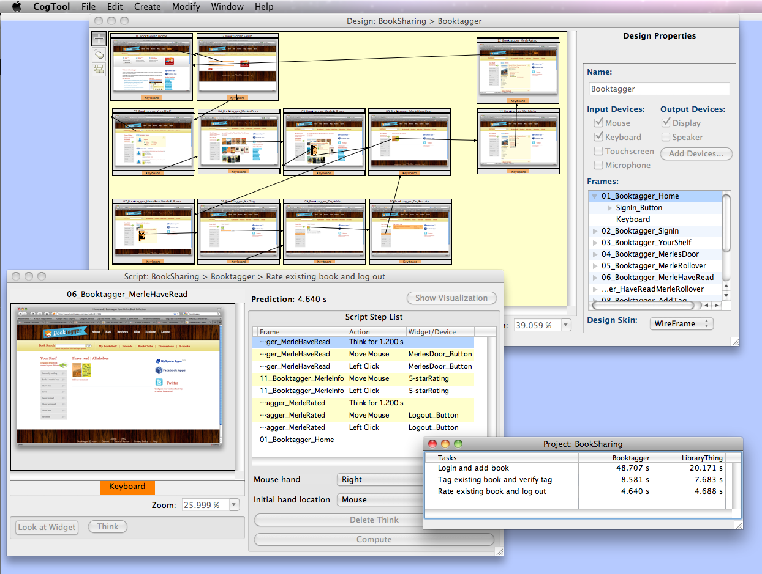
CogTool
1. Mockup a design in a storyboard
2. Demonstrate tasks
3. Hit “Compute” and predictions appear in a table
Notes:
Mocking up a design in a storyboard was inspired by
Lin, J., Newman, M. W., Hong, J., Landay, J. A. (2001) Denim: An Informal Tool for Early Stage Web Site Design. In CHI '01 Extended Abstracts on Human Factors in Computing Systems (CHI 2001), pp. 205--206 ACM, New York, NY
CogTool has the ACT-R cognitive architecture running “under the hood”
Anderson, J. R., Bothell, D., Byrne, M. D., Douglass, S., Lebiere, C., and Qin, Y. (2004) An integrated theory of the mind. Psychological Review, 111, (4). 1036-1060.
http://act-r.psy.cmu.edu/

Slide 17
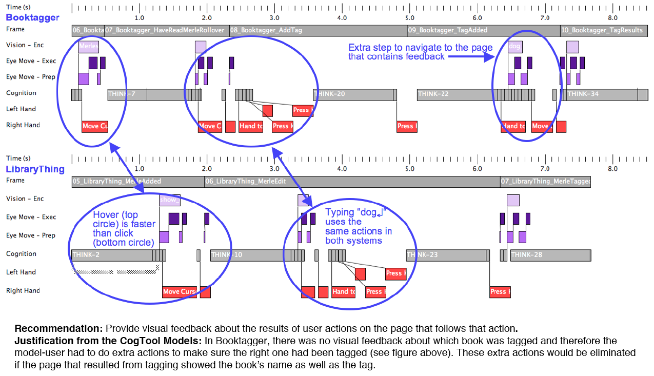
UI designers can use the visualization to extract design recommendations (John, 2011)
Notes:
John, B. E. (2011) Using Predictive Human Performance Models to Inspire and Support UI Design Recommendations. In Proceedings of CHI 2011. (Vancouver, BC, Canada, May 2011) ACM New York.

Slide 18
Three ways to build prototypes
Five
Import screen shots of existing systems
Useful for benchmarking current system or competitive analysis of existing products
This is the way we will do the hands-on exercises
Sketch design ideas & import the sketches
Useful for very early work, for user studies, or to communicate design ideas
See HandheldRecommender.cgt, by Laura Pelton
Use interactive widgets on a blank canvas
Useful as a prototyping tool
See TelephoneLookup.cgt
Automatically from existing HTML (not perfect, but sometimes useful, File>Import)
Automatically from legacy systems (Swearngin, Cohen, John, and Bellamy, CHI 2012)
Notes:
Swearngin, A., Cohen, M. B., John, B. E., and Bellamy, R. K. E. (2012). Easing the generation of predictive human performance models from legacy systems. Proceedings of CHI 2012 (Austin, TX, May 5-10, 2012). ACM, New York.

Slide 19
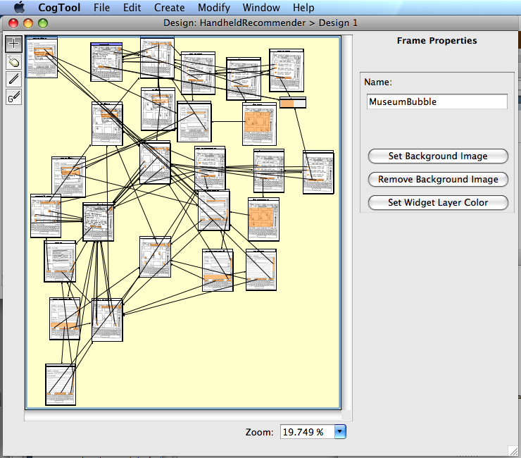
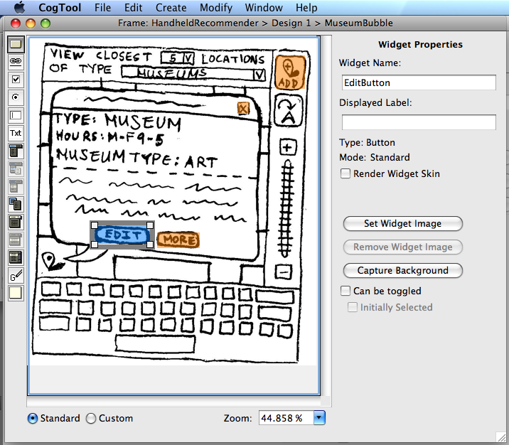
Sketch design ideas & import the sketches
HandheldRecommender.cgt, by Laura Pelton
Notes:
Illustration used by permission of Laura Pelton, aug2008

Slide 20
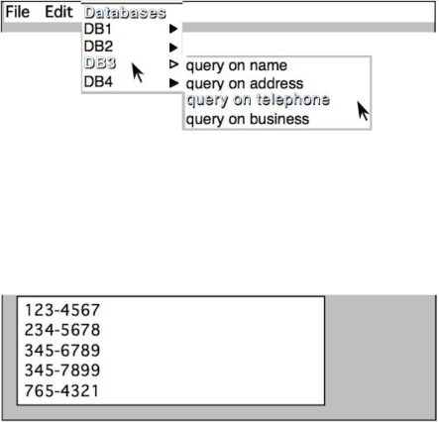
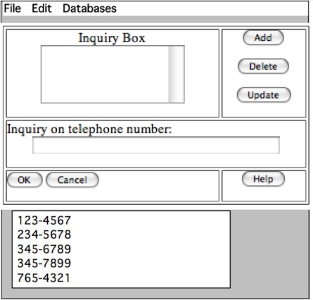
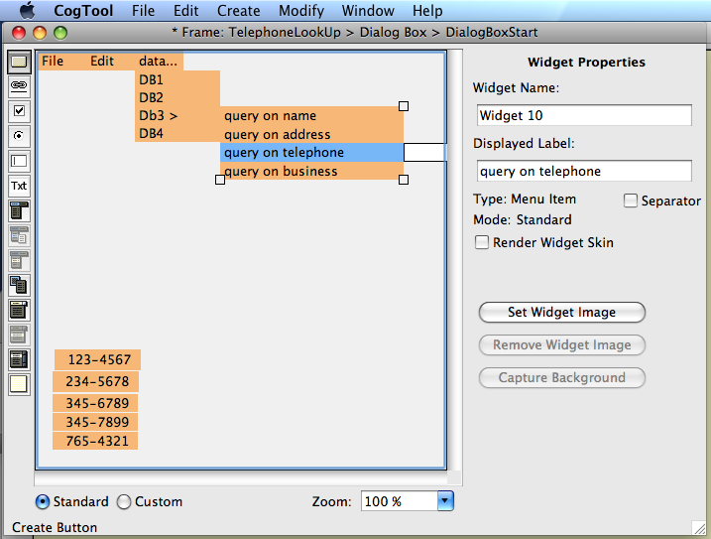
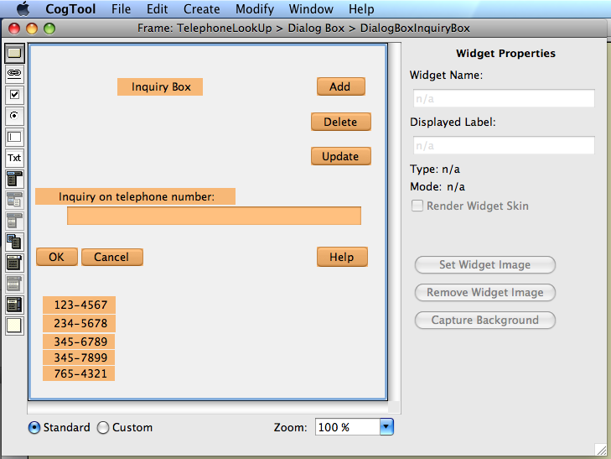
Use interactive widgets on a blank canvas
TelephoneLookup.cgt

Slide 21
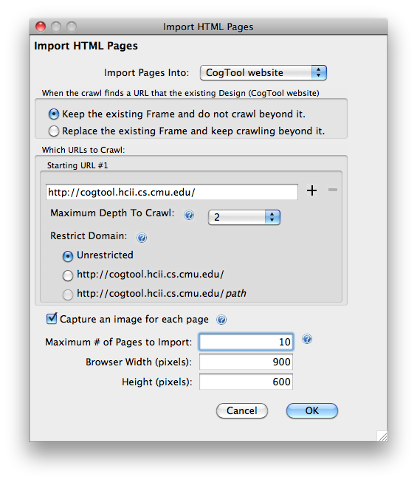
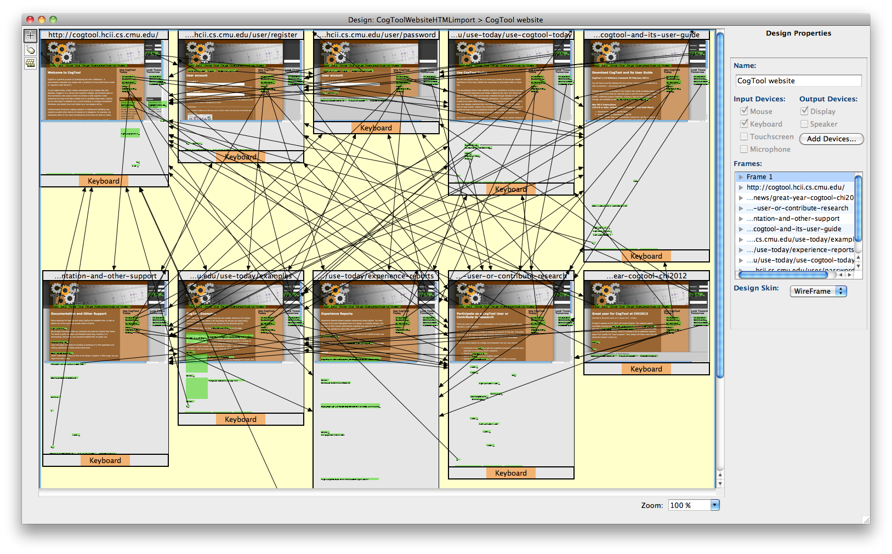
Import from HTML: File > Import Design from HTML…

Slide 22
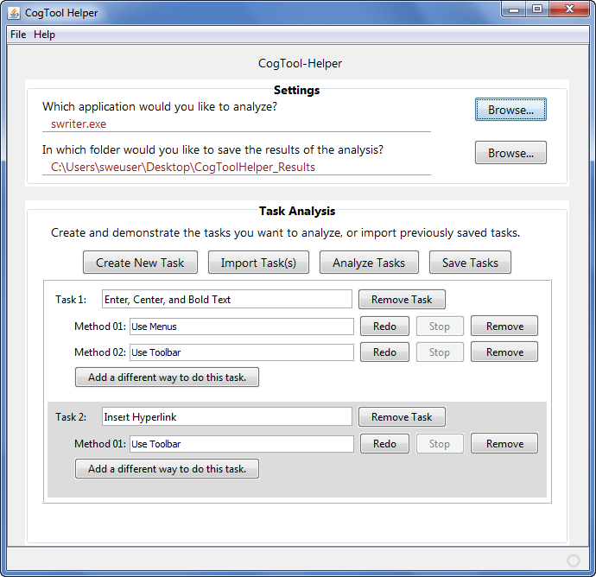
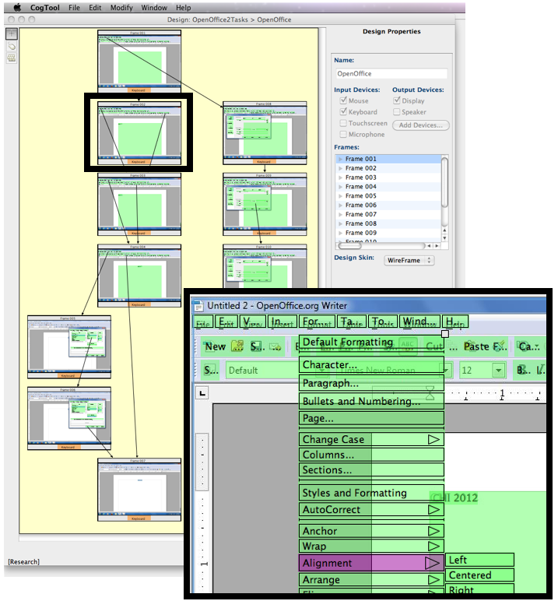
Automatically from Legacy Systems (Swearngin, et. al, 2012)
CogTool-Helper by
Amanda Swearngin
Notes:
Swearngin,A., Cohen, M., John, B. E, Bellamy, R. K. E. (2012) Easing the generation of predictive human performance models from legacy systems. Proceedings of the 2012 ACM annual conference on Human Factors in Computing Systems, pp. 2489--2498

Slide 23
Agenda of this workshop
Introduction to predictive human performance modeling
Introduction to CogTool
Hands-on exercises in CogTool
Break
Continuation of hands-on exercises
The future of predictive human performance modeling

Slide 24
Hands-on CogTool Course
Does everybody have CogTool on their computers?
Get the CogTool executable, for Mac or PC, and the User Guide at https://github.com/cogtool/cogtool/releases/tag/1.2.2
Get the Course Exercise Materials at https://github.com/cogtool/cogtool/releases
Hands-on exercise
I’ll explain an interface and a task.
I’ll get you started building a storyboard.
We’ll discuss your storyboard designs
I’ll show you how to make predictions.
But before we begin…
The resources you have for learning to use CogTool today and when you are back at work or school

Slide 25
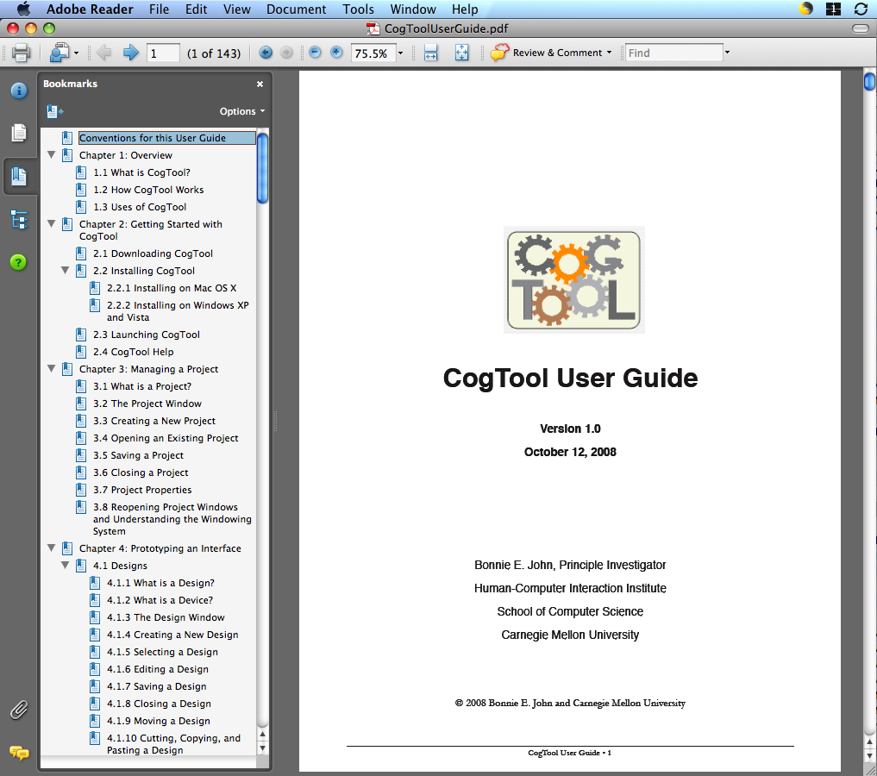
CogTool Resources
CogTool User Guide
PDF file
Bookmarked
Comment- enabled

Slide 26
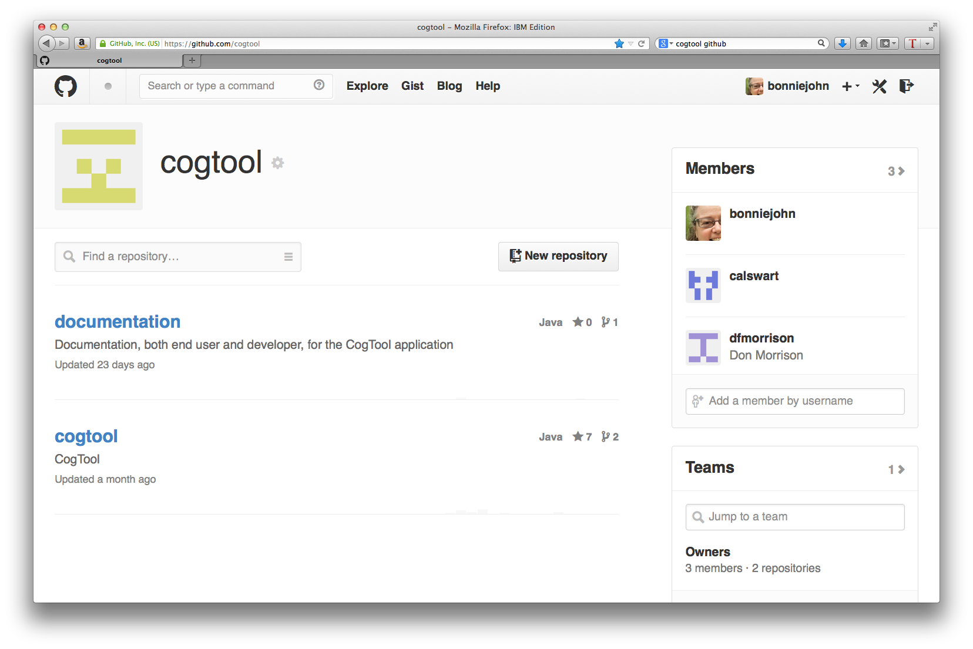
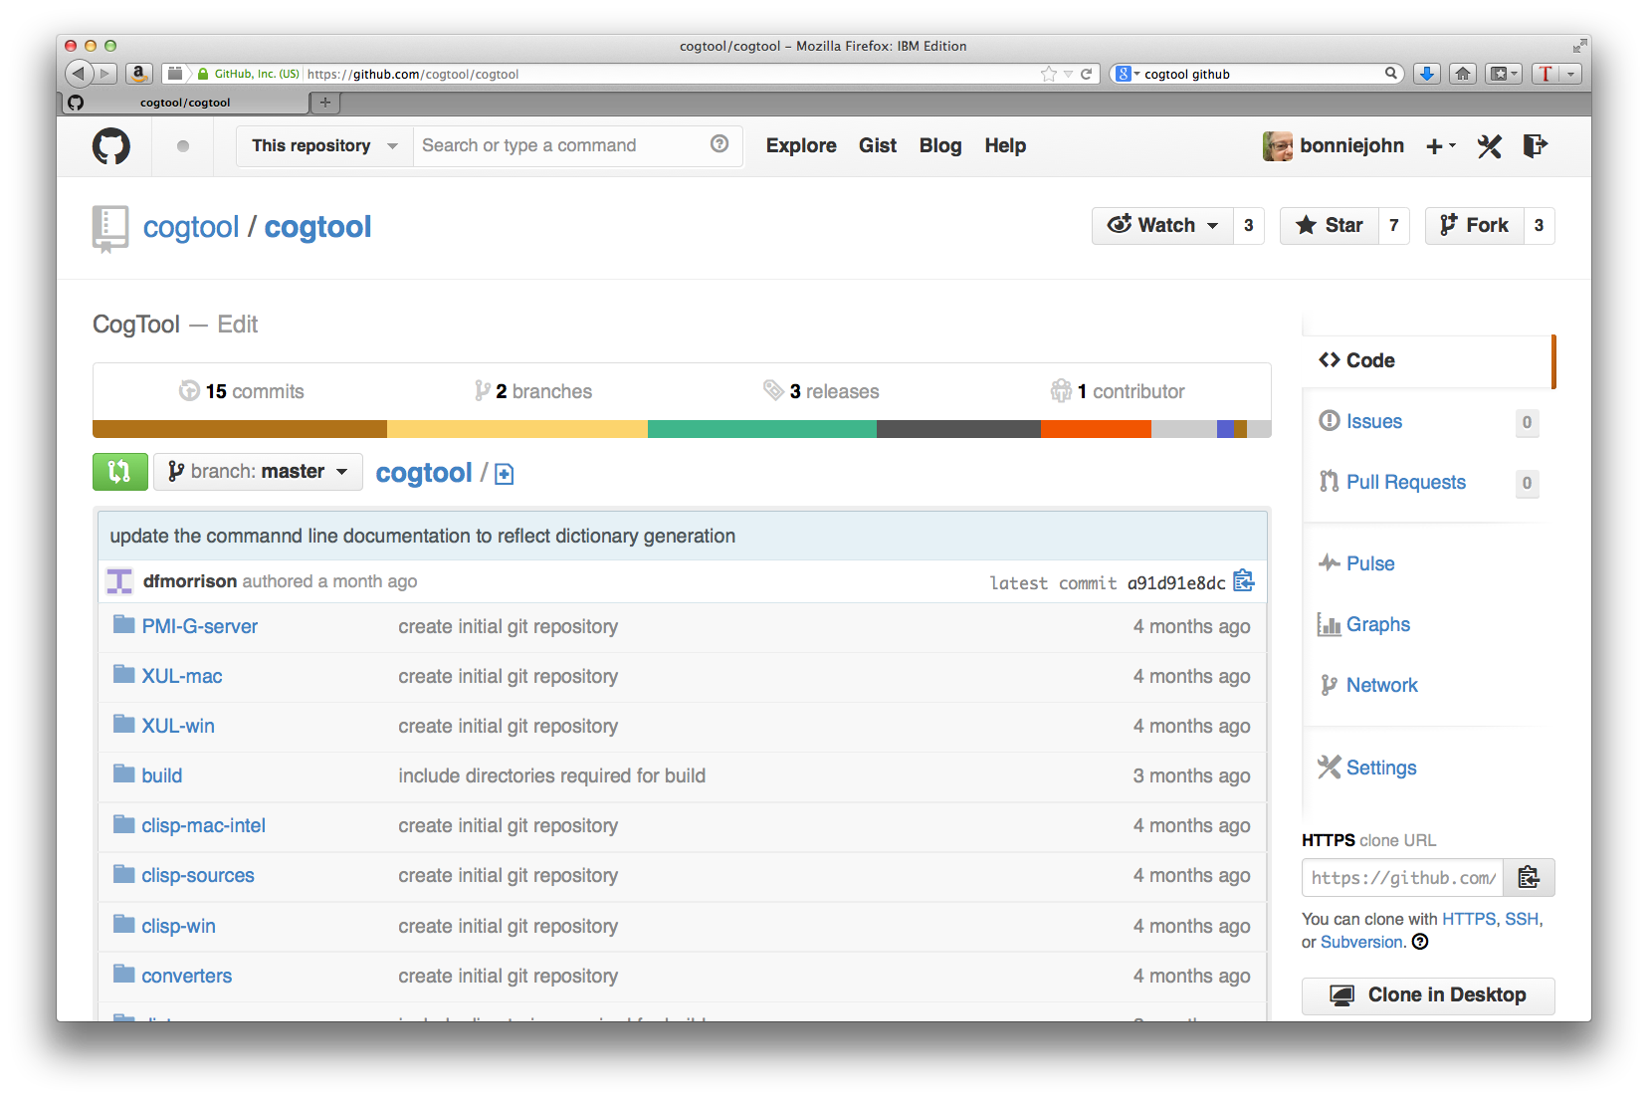
CogTool Sources
Releases
Executable code, source code, documentation sources, examples, at https://github.com/cogtool

Slide 27
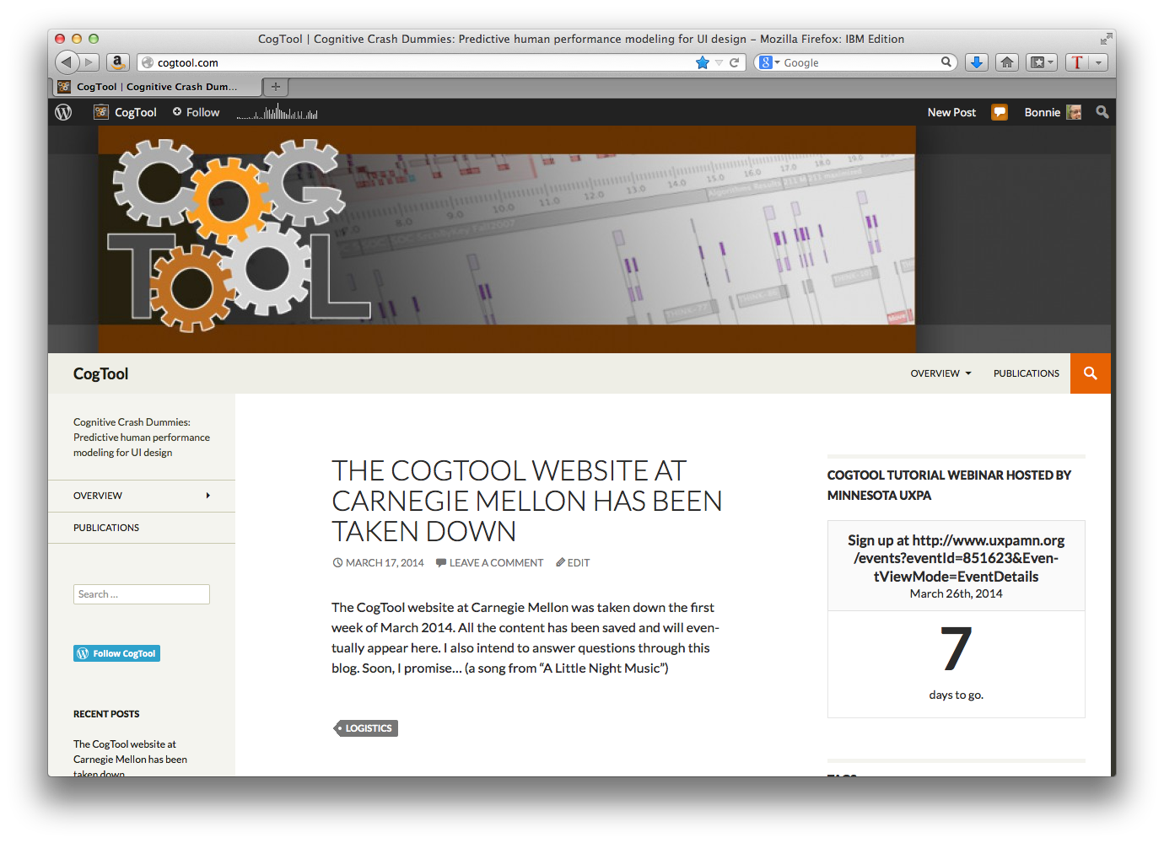
CogTool discussions
News, discussions, tips, other helpful materials at http://cogtool.com/

Slide 28
Interfaces and Task: Collaborative Shopping (CollaborativeShopping_TaskInstructions.pdf)
In the context of roommates shopping for a couch, this example compares three ways for people to share a link on craigslist, and a comment about the item. It compares GMail, Google Notebook, and a wiki set up with Wetpaint.
Assume:
The roommates are going to follow the link to see the page, so it doesn’t matter if the link is just a URL or a page title.
All screens load immediately unless otherwise noted.
The start screen is the craigslist listing of the couch to be shared.
Any necessary sharing has already been set up (i.e., GoogleMail group, GoogleNote sharing, wiki permissions), so all we are modeling here is how long it takes to share a single link with a comment.
The user’s hand starts on the mouse

Slide 29
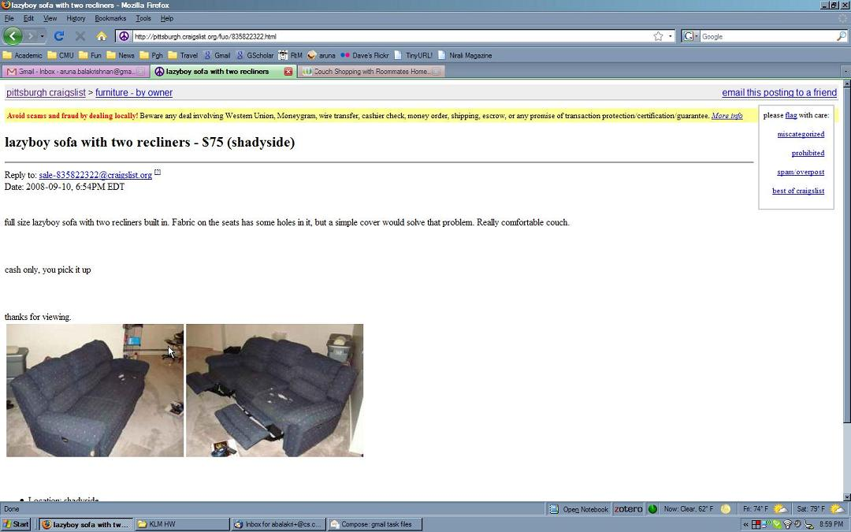
The task: Google Notebook method - Screen 1
Highlight the title of this post, “lazyboy sofa with two recliners - $75 (shadyside)” by triple-clicking on the text.

Slide 30
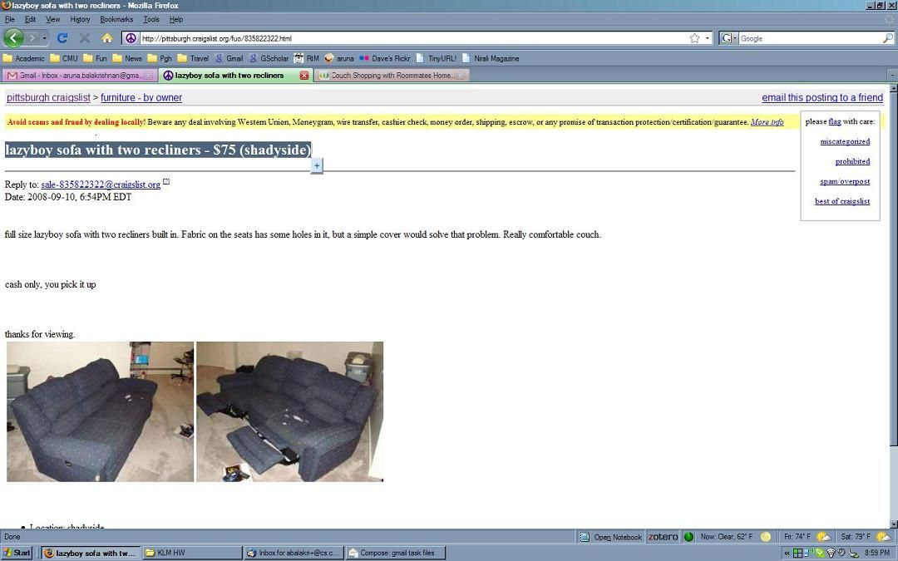
The task: Google Notebook method - Screen 2
Click on the plus sign that appears to the right of the highlighted title.

Slide 31

The task: Google Notebook method - Screen 3
Click on the “Note this” that appears in place of the plus sign.
After 1.25 seconds, the Google Notebook appears at the bottom right of the screen.

Slide 32
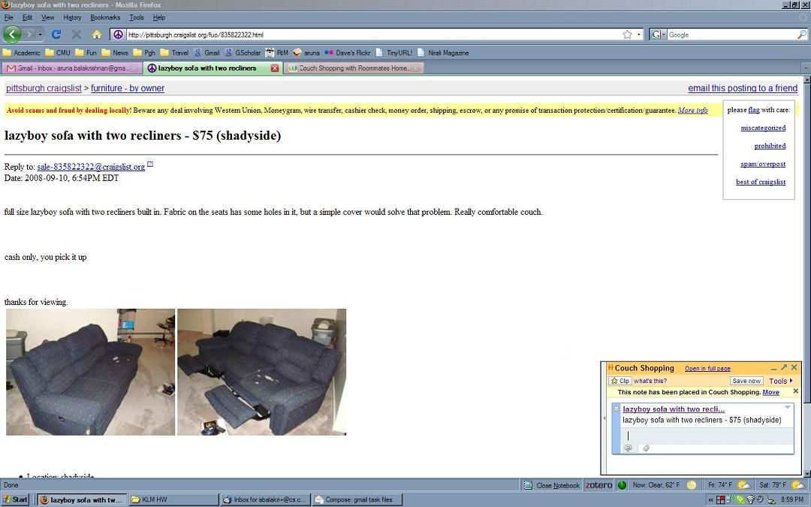
The task: Google Notebook method - Screen 4
The cursor is already in the comment field below the link.
Type “I like the color and price.”
Click on “Save now”

Slide 33

The task: Google Notebook method - End of Task
Look at “Saved”, which has changed from “Save now” which indicates that the link and comment have been saved.
This is the end of the task using Google Notebook.

Slide 34
Creating CogTool models
The project window
Columns are designs – In this course we will eventually have 3 columns
GoogleNotebook
GMail
Wetpaint
Rows are tasks – in this course, we will only have one row
Share link and comment
Additional tasks would be in additional rows
Each cell will contain a prediction of how long it would take a skilled user to perform the task on the UI design
I’ll make the model for the GoogleNotebook UI design and the Share_link_and_comment task
You follow along and create yoiur model

Slide 35
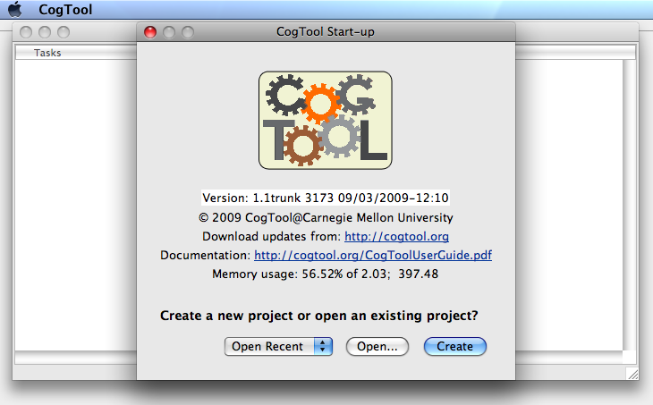
Open CogTool
Click Create

Slide 36
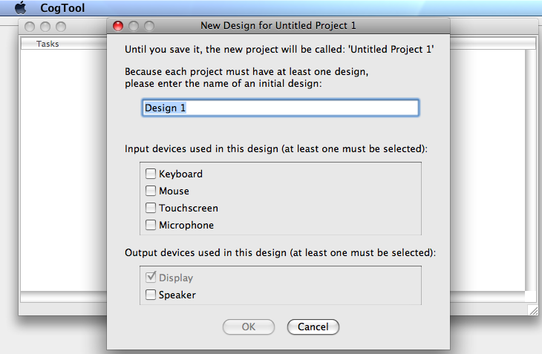
Create a new project
Fill in the name and devices of the Google Notebook interface

Slide 37
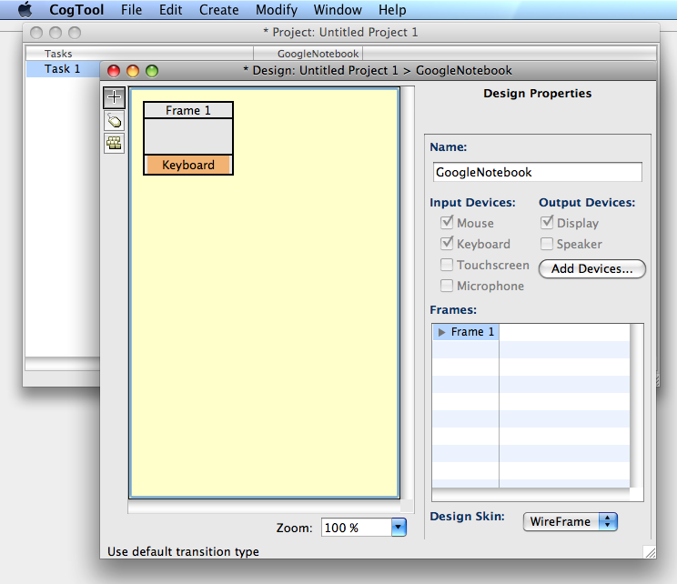
Ready to start mocking up the interface
Save this as MyCollaborativeShopping.cgt

Slide 38
Creating the Prototype of the Design
A prototype is expressed in a storyboard
Frames
Transitions from one frame to another
Each frame has the widgets it needs to do the task
Buttons, Menus, Text boxes, Text, etc.
All frames in a design also have access to the devices associated with the design
Keyboard, mouse, microphone, speaker, touch screen
Transitions represent actions on the widgets or devices
Transitions take the interface from frame to frame

Slide 39
Making a storyboard of the Google Notebook interface Creating the frames
What does the screen look like at each step in the task?
Because we are analyzing an existing system, we can import screen shots into frames
Choose Modify>Import Images as New Frames…
Navigate to the folder called ColaborativeShoppingImages
How do the things on each screen act?
What widgets act like that?

Slide 40
Making a storyboard of the Google Notebook interface Drawing transitions in the Design window
What would the users do at the start screen?
What feedback would a user get?

Slide 41
Making predictions about the Google Notebook interface Demonstrating a task & computing
Demonstrating a task creates a script
The script creates code that runs in the ACT-R cognitive engine (Anderson, et al., 2004) and makes a prediction of task execution time by a skilled user.
When you are done, hit compute and we’ll compare predictions
Notes:
Anderson, J. R., Bothell, D., Byrne, M. D., Douglass, S., Lebiere, C., and Qin, Y. (2004) An integrated theory of the mind. Psychological Review, 111, (4). 1036-1060.
http://act-r.psy.cmu.edu/

Slide 42
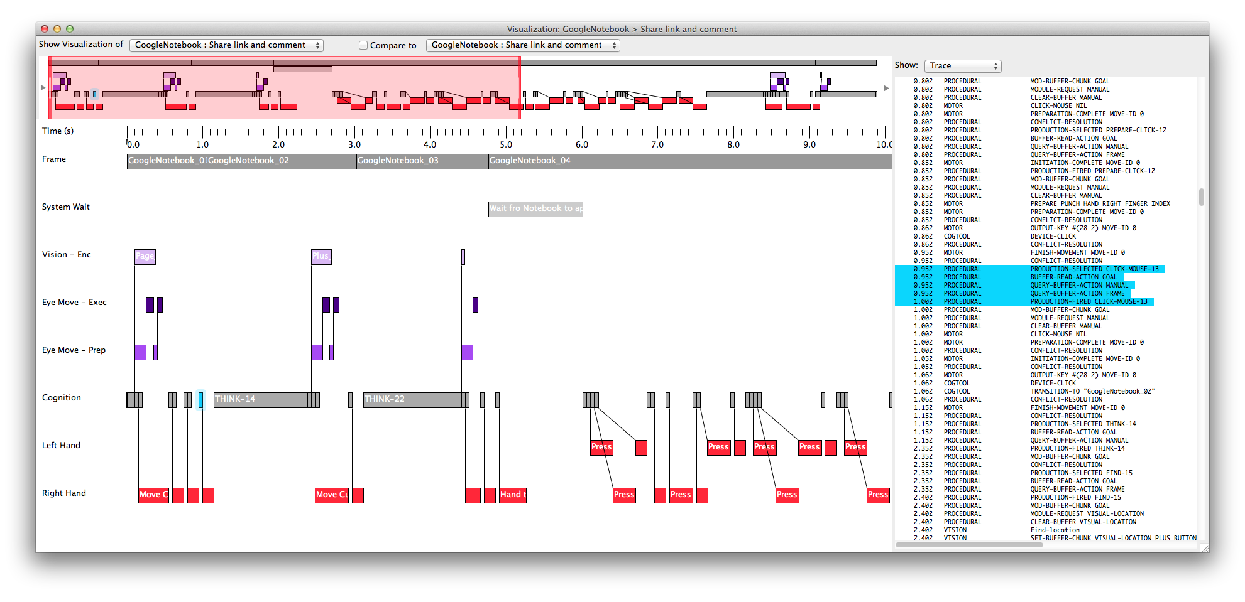
Making predictions about the Google Notebook interface Exploring the visualization
Overview (scale and slide)
System actions
Perception (eyes & ears)
Thoughts
Motor Actions (hands & voice)
Click on a area in the timeline and see the corresponding ACT-R trace
Computing creates an ACT-R trace that can be visualized in an interactive time-line

Slide 43
Now you create the models for GMail and WetPaint
You’ll work for a while on your own
If you have any questions, put them in the chat and I’ll answer them
Take a break whenever you want
When you finish, let me know
We’ll get back together when most people are done, discuss anything you’d like about the exercise
Let’s pick a time to reconvene

Slide 44
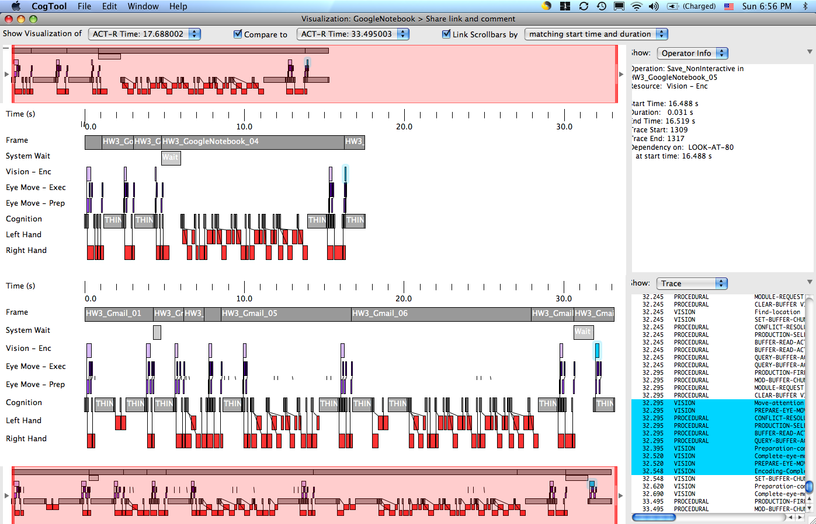
Visualization of Google Notebook and GMail

Slide 45
A completed comparison of the interfaces
… can be found in CollaborativeShopping.cgt

Slide 46
Agenda of this workshop
Introduction to predictive human performance modeling
Introduction to CogTool
Hands-on exercises in CogTool
Break
Continuation of hands-on exercises
The future of predictive human performance modeling

Slide 47
Remember when I introduced CogTool?
Goal: Make it easier to construct human behavior models
Reduce the cost of learning and creating valid cognitive models
“Toe in the door” philosophy
First, make the simplest models really really easy
Hope that interest in more powerful, but complex, modeling will follow
Gradually expand the power of the tool without sacrificing usability
Expand the scope of what models can predict, e.g.,
New domains beyond office work
Other measures besides task execution time of skilled users

Slide 48
Reducing the cost of modeling so it can be a practical tool
Five cases at IBM in 2010 (Bellamy, John & Kogan, 2011)
contract compliance
communication within a product team and between a product team and its customer
assigning appropriate personnel to fix customer complaints
quantitatively assessing design ideas before a line of code is written
Recent case at IBM doing collaborative, distributed modeling (John, Starr & Utesch, CHI 2012)
Notes:
Bellamy, R., John, B. E., Kogan, S. (2011) Deploying CogTool: Integrating quantitative usability assessment into real-world software development. In Proceeding of the 33rd international conference on Software engineering (ICSE '11). ACM, New York, NY, USA, 691-700.
John, B. E., Starr, S. M., and Utesch, B. S. (2012). Experiences with collaborative, distributed predictive human performance modeling. Extended Abstracts of CHI 2012 (Austin, TX, May 5-10, 2012). ACM, New York.

Slide 49
New domains beyond office work: Mobile Aps
Luo & John, CHI 2005 (with updated numbers)
More on this later, when we talk about new measures
-8.9%
-5.8%
9.3%
-7.7%
Notes:
Luo, L. & John, B. E. (2005) Predicting task execution time on handheld devices using the Keystroke-Level Model. Extended Abstracts of CHI 2005 (Portland, Oregon, April 2-7, 2005) ACM, New York. 1605 – 1608.

Slide 50
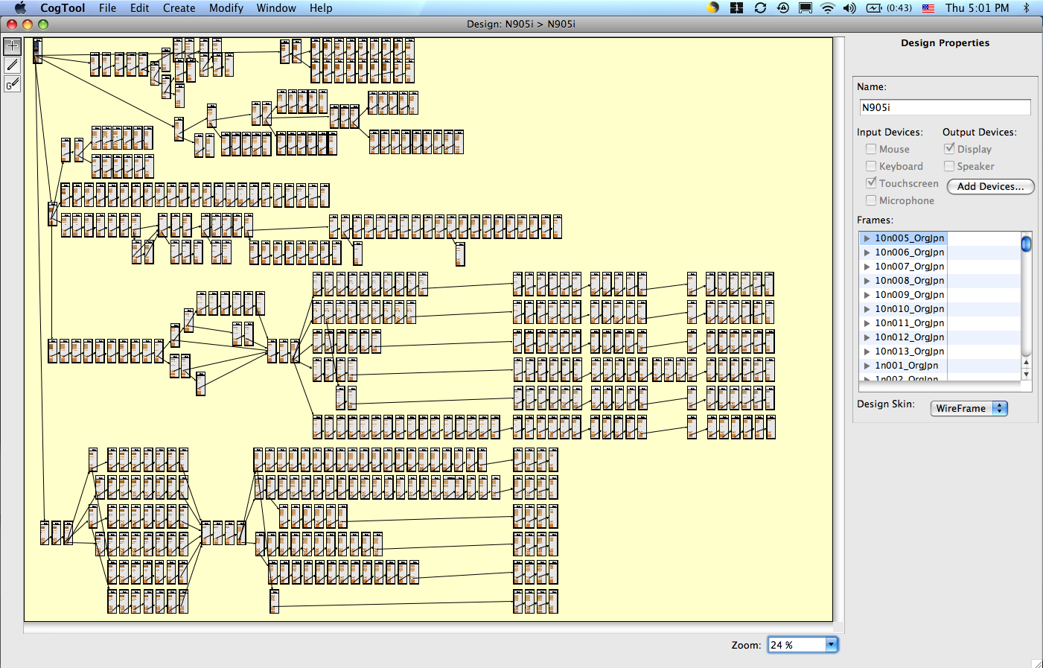
Cellphones (John & Suzuki, 2009)
A comparison of 3 cell phones on 10 tasks
Many improvements to the tool, to make this modeling tractable

Slide 51
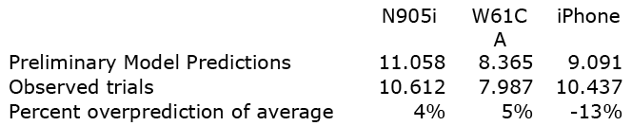
Cellphones CogTool “out-of-the-box” predicted skilled performance quite well
Not as good a match to the iPhone, probably because of the new motor operators, e.g., flick, drag, stretch
Notes:
John, B. E., and Suzuki, S. (2009) Toward Cognitive Modeling for Predicting Usability. Human-Computer Interaction. New Trends, 13th International Conference, HCI International 2009 (San Diego, CA, USA, July 19-24, 2009).

Slide 52
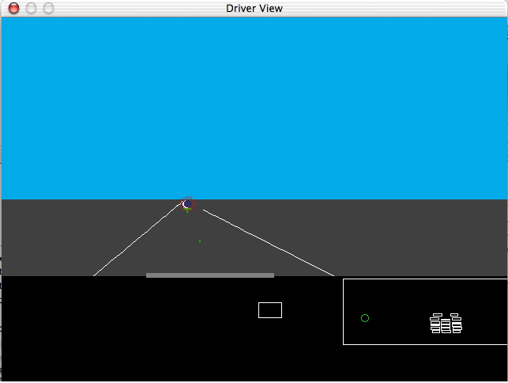
Driving with In-Vehicle Information Devices (John & Salvucci, 2005)
Old version of CogTool that has suffered from code-creep
Notes:
John, B. E. & Salvucci, D. D. (2005) Multi-purpose prototypes for assessing user interfaces in pervasive computing systems. IEEE Pervasive Computing 4(4), 27-34.

Slide 53

Distract-R
Distract-R Demo
Dario Salvucci at Drexel has a system called Distract-R (Salvucci, 2009)
http://www.cs.drexel.edu/~salvucci/distract-r.html
Notes:
http://www.cs.drexel.edu/~salvucci/distract-r.html
Dario D. Salvucci. 2009. Rapid prototyping and evaluation of in-vehicle interfaces. ACM Trans. Comput.-Hum. Interact. 16, 2, Article 9 (June 2009).

Slide 54
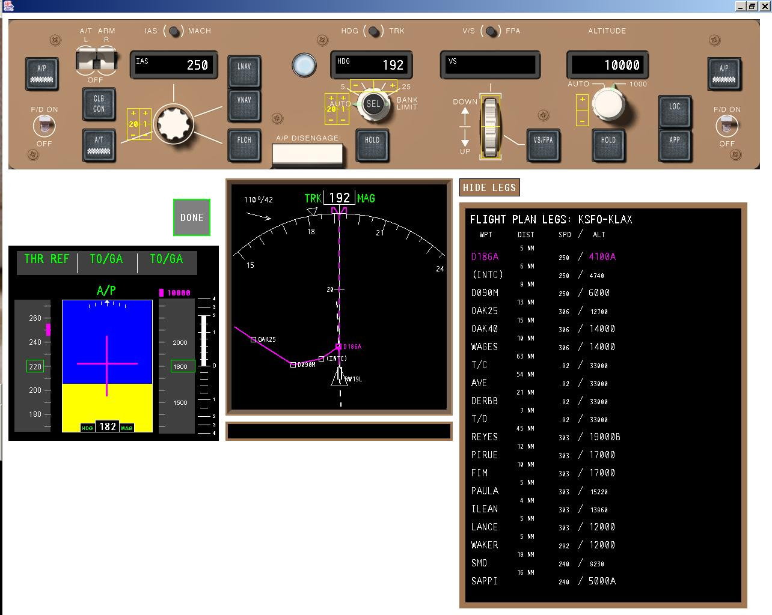
Flight Deck Design

Slide 55
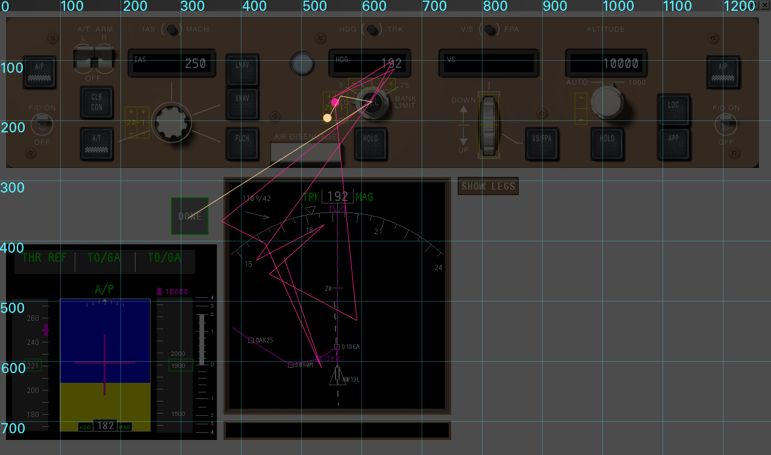
Human performance data on a suite of benchmark tasks (GMU, Ricardo Prada)

Slide 56
Time investment in modeling
Building a storyboard like this for a design
~1 hour/design
Demonstrating each task and computing the prediction
~30 sec/task
Compare this investment to how long it would take to build a running prototype, recruit skilled pilots, train them on the different designs, runs the experiments and analyze the data

Slide 57
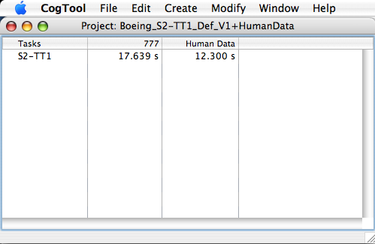
Accuracy of models
To equalize starting point, -4.150
13.489
10% difference

Slide 58
10% difference. Sounds pretty good for an hour’s worth of work
10% different from what?
Pilot at a computer (not in a cockpit)
Error-free, skilled performance time for specified tasks
Even with these limitations, predictions can be useful
The speed of storyboarding and modeling allows designers to explore many ideas and eliminate the poor ones before further prototyping and testing with human pilots

Slide 59
All of the preceding can already be done with CogTool¹
They don’t have 30 years of research validating the models’predictions, yet, but they are on the way
Any questions before we move on to predicting other metrics of human performance?
¹Not necessarily the version distributed at this course.

Slide 60
Other measures besides task execution time of skilled users
Energy expenditure
Novice exploration behavior, including errors

Slide 61
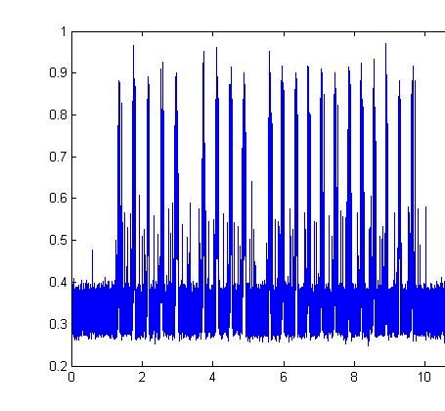
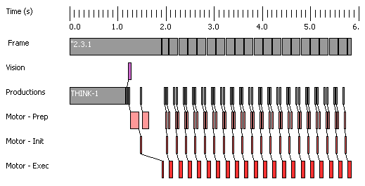
Keystroke-Level Energy Modeling (Luo & Siewiorek, 2007)
Maps pre-established energy profiles to user actions, e.g., tapping on a touch-screen, using voice recognition
Prediction error for skilled task execution time:
5.6% for iPaq
8.8% for Tungsten
Prediction error for energy usage during skilled use:
4.4% for iPaq
8.4% for Tungsten
Notes:
Luo, L. & Siewiorek, D. P. (2007) KLEM: A method for predicting user interaction time and system energy consumption during application design. 11th International Symposium on Wearable Computers, Boston, MA, October 2007.

Slide 62
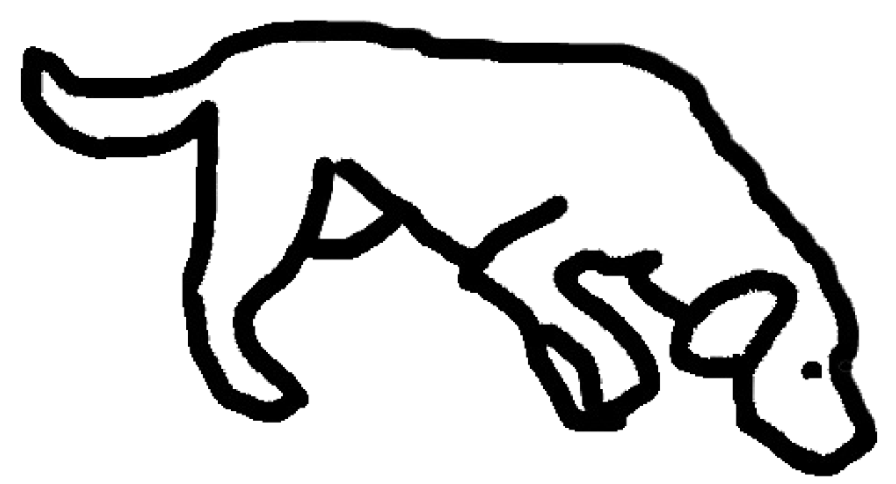
Predicting Exploratory Behavior
Given an information-finding task and access to the web, how would you find that information?
Given a task and a new application, how would you go about accomplishing that task?
A theory that explains exploratory behavior is called Information Foraging (Pirolli, 2007)
Notes:
Pirolli, P. (2007). Information Foraging Theory: Adaptive Interaction with Information. Oxford University Press, USA.

Slide 63
CogTool-Explorer puts Information Foraging under the hood (Teo, John & Blackmon, CHI 2012)
Instead of demonstrating a task and getting a prediction of skilled performance time, you give CogTool-Explorer a goal and an interface and tell it to explore the interface to accomplish the goal
You get predictions of novice exploration behavior, including errors
Notes:
Teo, L., John, B. E. John, and Blackmon, M. H. (2012). CogTool-Explorer: A model of goal-directed user exploration that considers information layout. Proceedings of CHI 2012 (Austin, TX, May 5-10, 2012). ACM, New York.

Slide 64
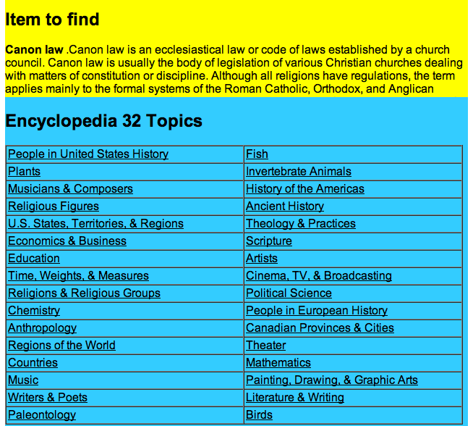
Consider the task of finding information about “canon law”
Blackmon, et al., 2002
Notes:
Blackmon, M. H., Polson, P. G., Kitajima, M., & Lewis, C. (2002). Cognitive walkthrough for the web. In Proceedings of the SIGCHI Conference on Human Factors in Computing Systems. CHI '02. ACM, 463-470.

Slide 65
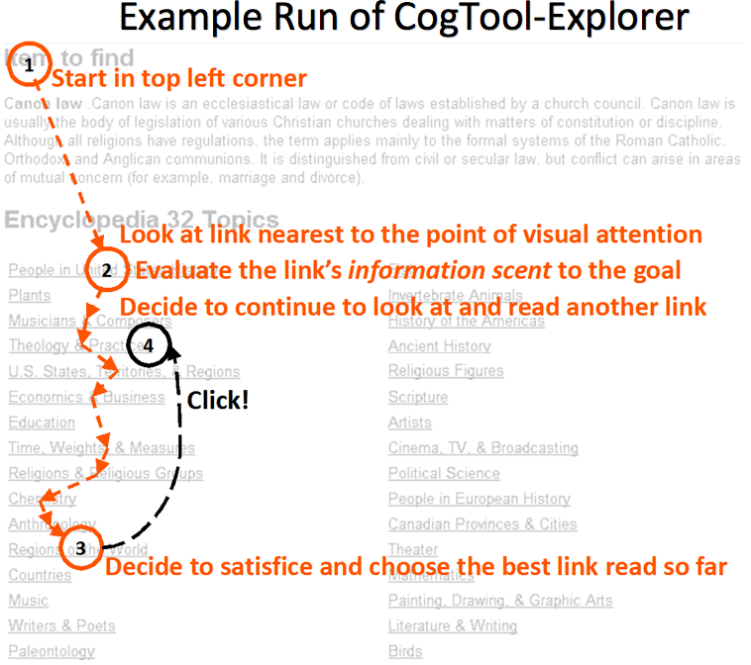
Example Run of CogTool-Explorer

Slide 66
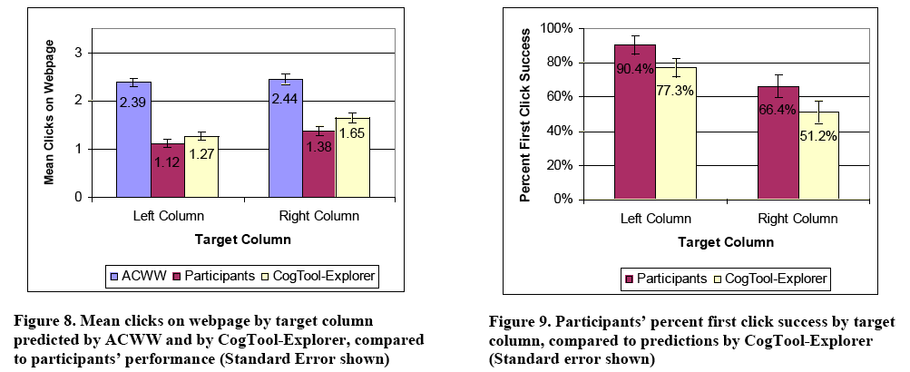
Effect of target position (left or right column)
Reanalysis of data in (Blackmon et al., 2002)
Paper presented at HFES 2008, Teo & John
Notes:
Teo, L. & John, B. E. (2008) Towards Predicting User Interaction with CogTool-Explorer. Proceedings of the Human Factors and Ergonomics Society 52nd Annual Meeting (New York City, New York, Sept 22-26, 2008). 950-954.

Slide 67
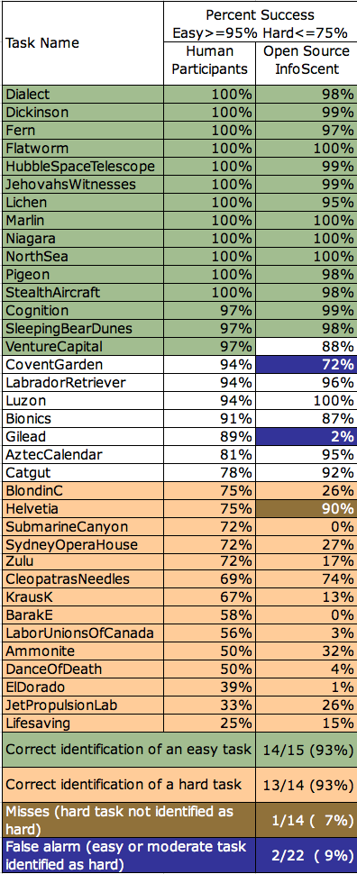
CogTool-Explorer can identify hard and easy tasks (Teo, John & Blackmon, 2012; John, et al., 2013)
In a test of 36 tasks, CogTool-Explorer
Correctly identified
93% of the easy tasks
93% of the hard tasks
Missed only one hard task (7%)
False alarm on only 2 tasks (9%)
This information provides UI designers a focus for their design work
Redesign the UI only for those tasks that need it (the hard tasks)
Preserve the UI of the easy tasks to keep them easy
Notes:
Teo, L., John, B. E., & Blackmon, M. H. (2012). CogTool-Explorer: A model of goal-directed user exploration that considers information layout. Proceedings of CHI 2012 (Austin, TX, May 5-10, 2012). ACM, New York.
John, B. E., Swart, C., Bellamy, R. K., Blackmon, M. H., & Brown, R. (2013) An Open Source Approach to Information Scent. Extended Abstracts of CHI 2013 (Paris, France, April 27-May 3, 2013). ACM, New York.

Slide 68
My hopes for this course (same as the goals of the CogTool research program)
It’s easy for you now; use modeling when appropriate in your work
Help us expand to new domains; e.g., contribute data
Keep an eye out for new research publications and opportunities to contribute
Become involved in the CogTool research community: http://cogtool.com/
Goal: Make it easier to construct human behavior models
Reduce the cost of learning and creating valid cognitive models
“Toe in the door” philosophy
First, make the simplest models (KLM) really really easy
Hope that interest in more powerful, but complex, modeling will follow
Gradually expand the power of the tool without sacrificing usability
Expand the scope of what models can predict, e.g.,
New domains beyond office work
Other measures besides task execution time of skilled users

Slide 69
Any questions?
With thanks to:
The HCI Institute at CMU Gus Prevas, Ken Koedinger, Peter Centgraf, Mike Horowitz, Alex Eiser, Alex Faaborg, Sandy Esch, Jason Cornwell, Lily Cho, Don Morrison, Samantha Konwinski, Carmen Jackson, Josh Ehlke, Ryan Myers, Diana Dill, Leigh Johnston, Chris Monti, Melissa Gallagher, Annie Luo, Brett Harris, Khaled Ziyaeen
IBM Research Rachel Bellamy, Shari Trewin, Cal Swart, John Thomas, John Richards
DSO National Laboratories, Singapore Leonghwee Teo
NASA Ames Research Center Alonso Vera, Collin Green, Guy Pryzak, Mike Feary
University of Michigan Rick Lewis, Mason Smith
University of Manchester Andrew Howes
PARC Peter Pirolli, Wai-Tat Fu, Victoria Bellotti, Nick Yee
Drexel University Dario Salvucci
George Mason University Lance Sherry, Maricel Medina Mora
University of Colorado Marylin Hughes Blackmon, Peter Polson, Karl Fennel, Richard Brown
University of Nebraska, Lincoln Myra Cohen, Amanda Swearngin
Oregon State University David Piorkowsky
The ACT-R community
US Office of Naval Research
Boeing
NEC, Japan

